Slide 1
HIVEMIN(e)d

Slide 2
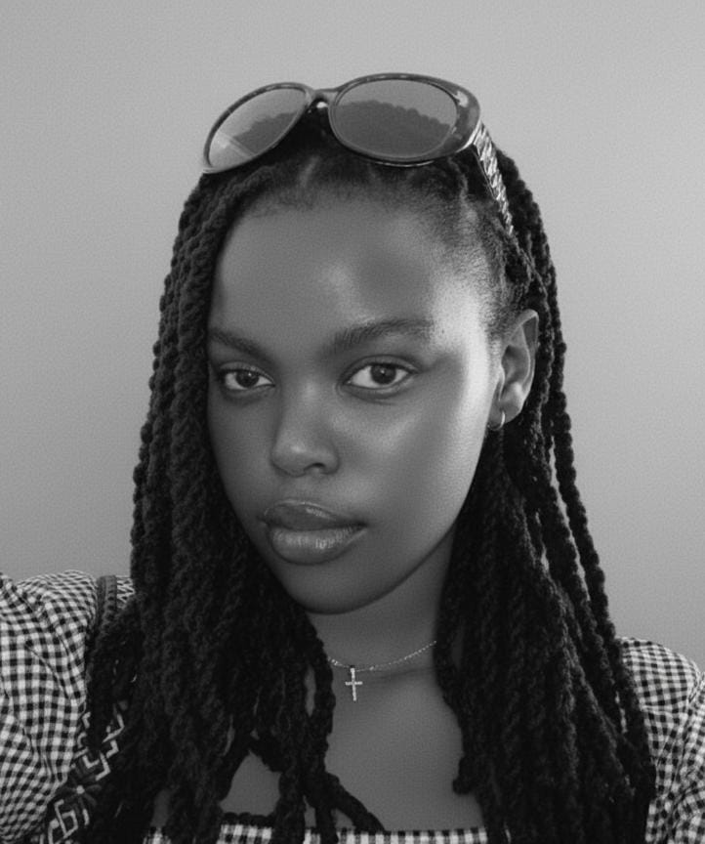
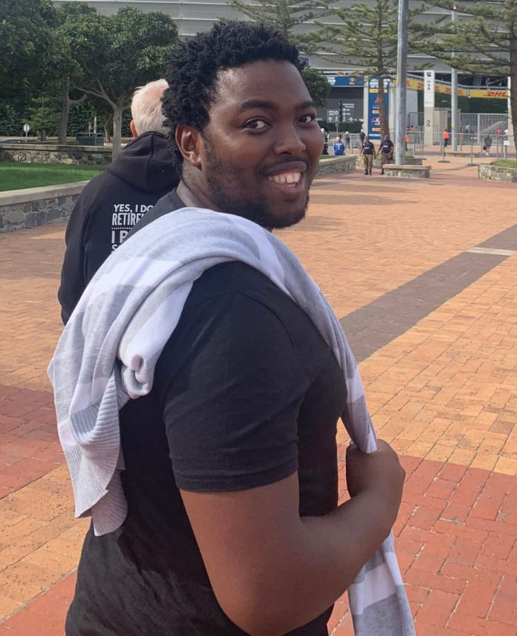
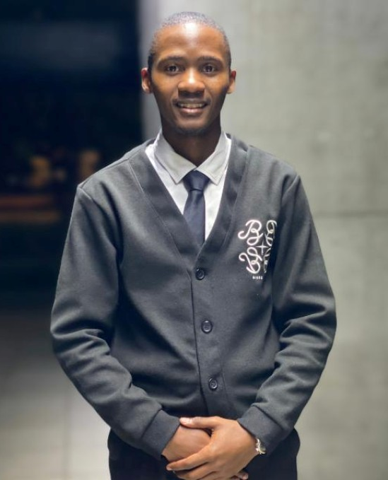
MEET
THE TEAM
Mihle Sokani
Ludwe Sokani
Thandolwethu
Mangesana
Designer
Developer
Developer

Slide 3
Learning and Connection Shouldn’t Cost a Fortune
There is a lack of affordable access to skill development Many people can’t afford paid courses or workshops, limiting their ability to learn new skills.
There is limited opportunities for community connection and knowledge exchange People with valuable skills often lack a platform to share and exchange them in a fair, collaborative way without involving money.
THE PROBLEM

Slide 4
Bridging the Skill Gap for Everyone
We built this app to help people who want to learn connect with people who love to share — for free.
The app will aim to give learners both young, and young at heart, a chance to learn from someone with a genuine love for sharing their passion. There will be no barrier of entry, anyone with time and a location will be able to share.
THE SOLUTION

Slide 5
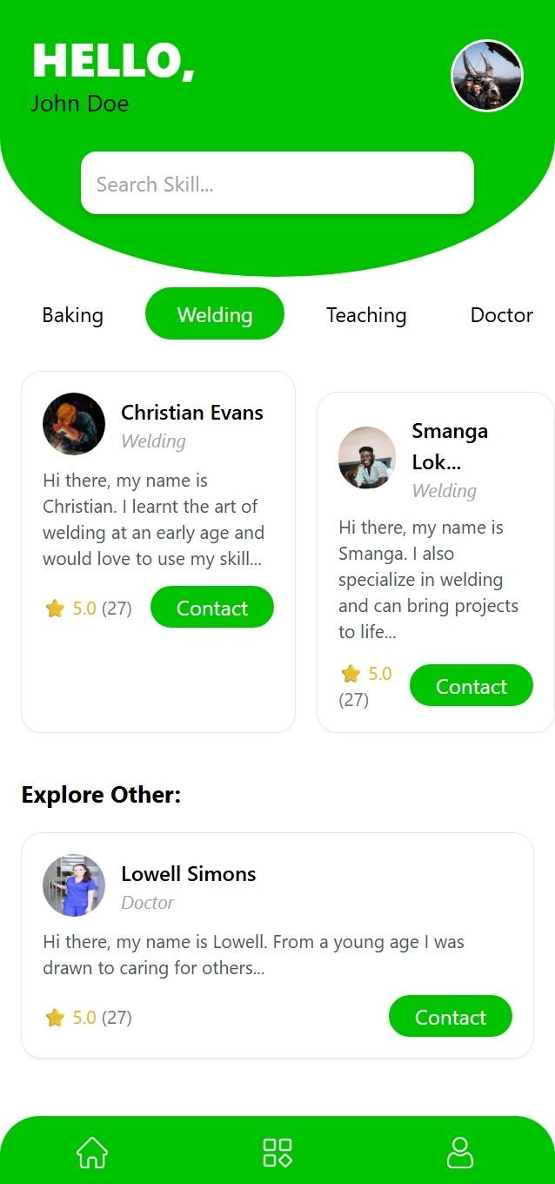
HOW IT WORKS
Users will be able to log into the app and search for or browse through a list of different skills and select the one they need
They will then be able to select someone who is willing to share and communicate with them, specifying what skills they have to trade with the person.
After they are done, they will then be able to rate the person (and be rated themselves) and this will have an effect on their star rating.

Slide 6
When everyone can learn. Everyone can teach.
This app is for learners hungry to grow, sharers eager to give back, and communities that thrive when knowledge flows freely.
It breaks down barriers to learning whilst also inspiring growth through giving and gaining. Strengthening communities through real connections, and making knowledge a shared power, not a product.
THE IMPACT

Slide 7

WHAT’S
NEXT
Adding some form of gamification; badges, milestones, etc. to reward those who share most.
Working on a proper logo and a UI that matches the name.

Slide 8
LEARNINGS
We learnt how to develop a figma mock-up from scratch, coming up with a design and thinking larger than just making something look good, but to also be functional.
We had a chance to work on using tailwind and figuring it out as we went along the process, given that we haven’t used it too much.
A key takeaway is also realising that development/design is only one part of a bigger puzzle and that to get the most out of a eam, it is important to remember to keep others in mind so everyone shines together.

Slide 9
THANK
YOU!
October/2025
Mihle, Ludwe, Thandolwethu
Contact info:
ludwesokani@gmail.com, mangesanathandolwethu@gmail.com
One Hive, mined.

